Slide 1
Group E
Kunchala Anil

Slide 2

Machine Failure Debris System

Slide 3

WHAT
Technology Demonstration Payload
Deorbiting the Satellite in case of mission failure within the mission duration by using feedback mechanism .

Slide 4
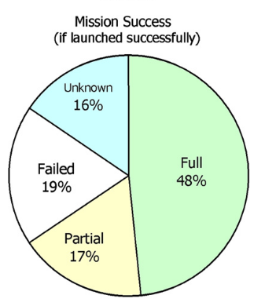
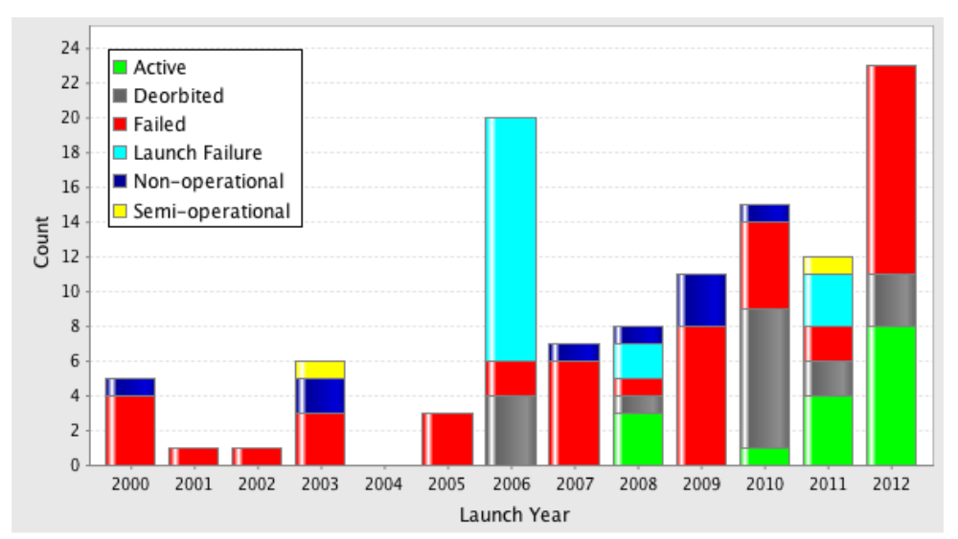
WHY
Success rates of pico- and nanosatellites (until 2009) [1]
Mission Status by Launch Year for First one hundred Cubesats [2]
J. Bouwmeester, J. Guo “Survey of worldwide pico- and nanosatellite missions, distributions and subsystem technology”
Michael Swartwout “The First One Hundred CubeSats: A Statistical Look”

Slide 5
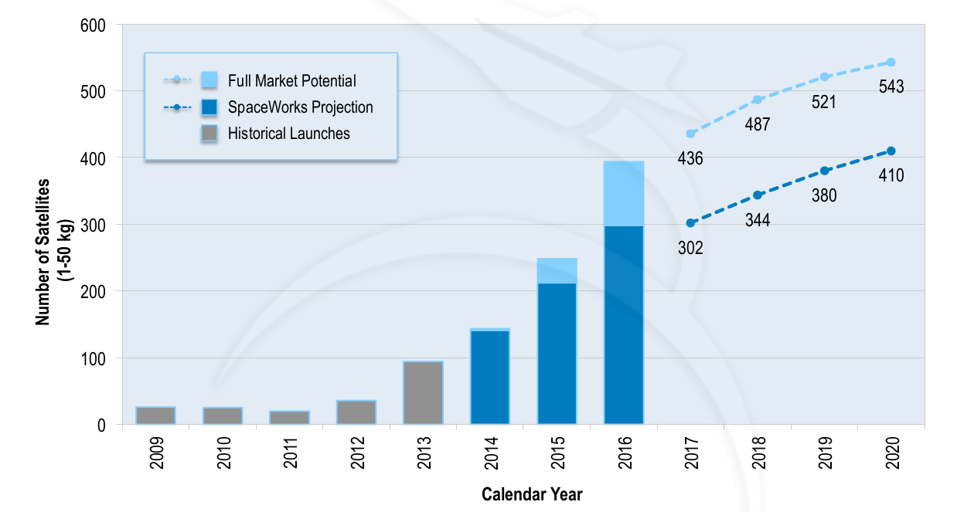
WHY
The target mission duration of the satellites is unknown for more than half of the 94 pico- and nanosatellites, especially for the educational satellites,
for the known pico- and nanosatellites they vary from a few days up to five years[1]
Why wait until the end of mission duration when mission is failed

Slide 6
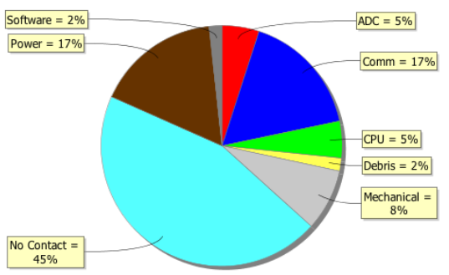
HOW
There are De-Orbiting Mechanism Is available to reduce the Space Debris.
Trigger a De-Orbiting Mechanism When Mission is Failed due to any one or multiple subsystem failure by having a feedback mechanism for all subsystems
Causes for CubeSat Mission Failure, 2000-2012 [2]

Slide 7
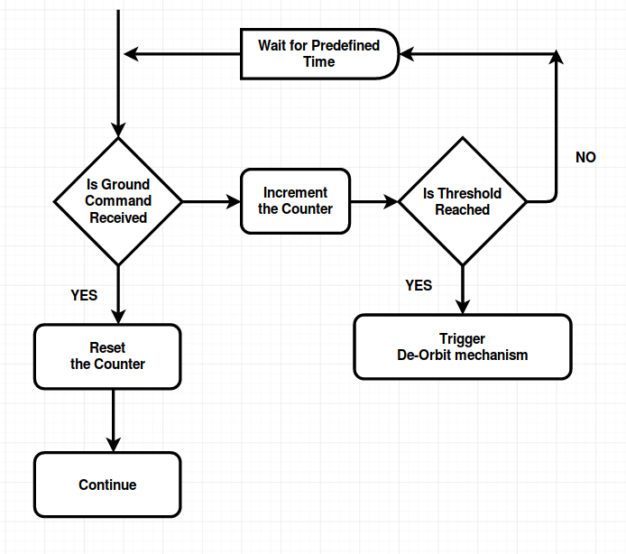
Comm & No Contact
Generalised
View

Slide 8
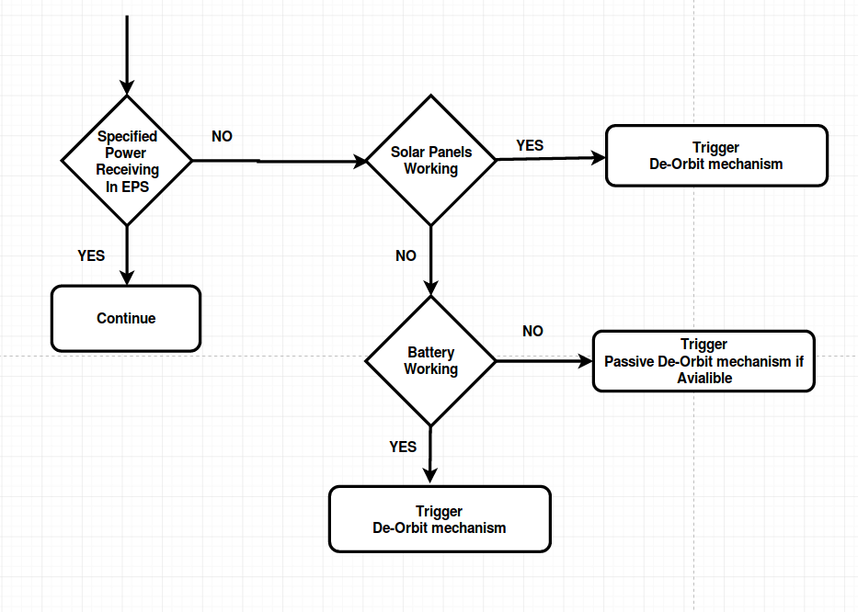
Power
Generalised
View

Slide 9
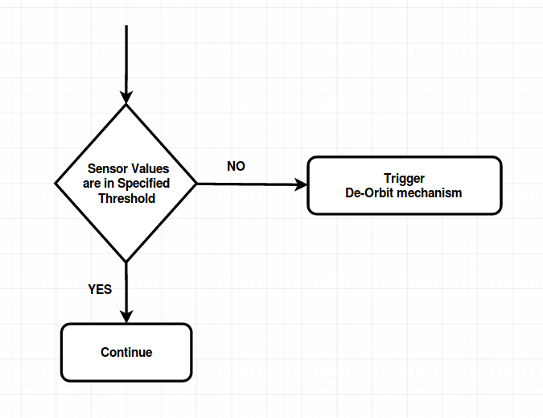
ADC & Mechanical
Generalised
View

Slide 10
How it works
Step 3
Step 2
Step 1
Trigger the De-Orbiting Mechanism if any subsystem fails which results mission failure
Check for Data Validation or Subsystem Functionality
Get the Feedback from subsystem using Interfaces like SPI,I2C

Slide 11

The Methodology:
DeOrbiting + Automatic Trigging Based on Feedback

Slide 12

Queries ?

